Slide 1
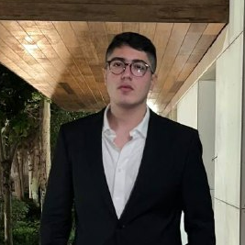
Hello!
I am Arshak Rezvani
You can find me at @ArshakRz

Slide 2

Comparison of Multi-Channel EEG Based Graph Learning Methods
Supervisor: Dr. Mohammad B. Shamsollahi
Tutor: Dr. Babak Khalaj
#WomanLifeLiberty

Slide 3
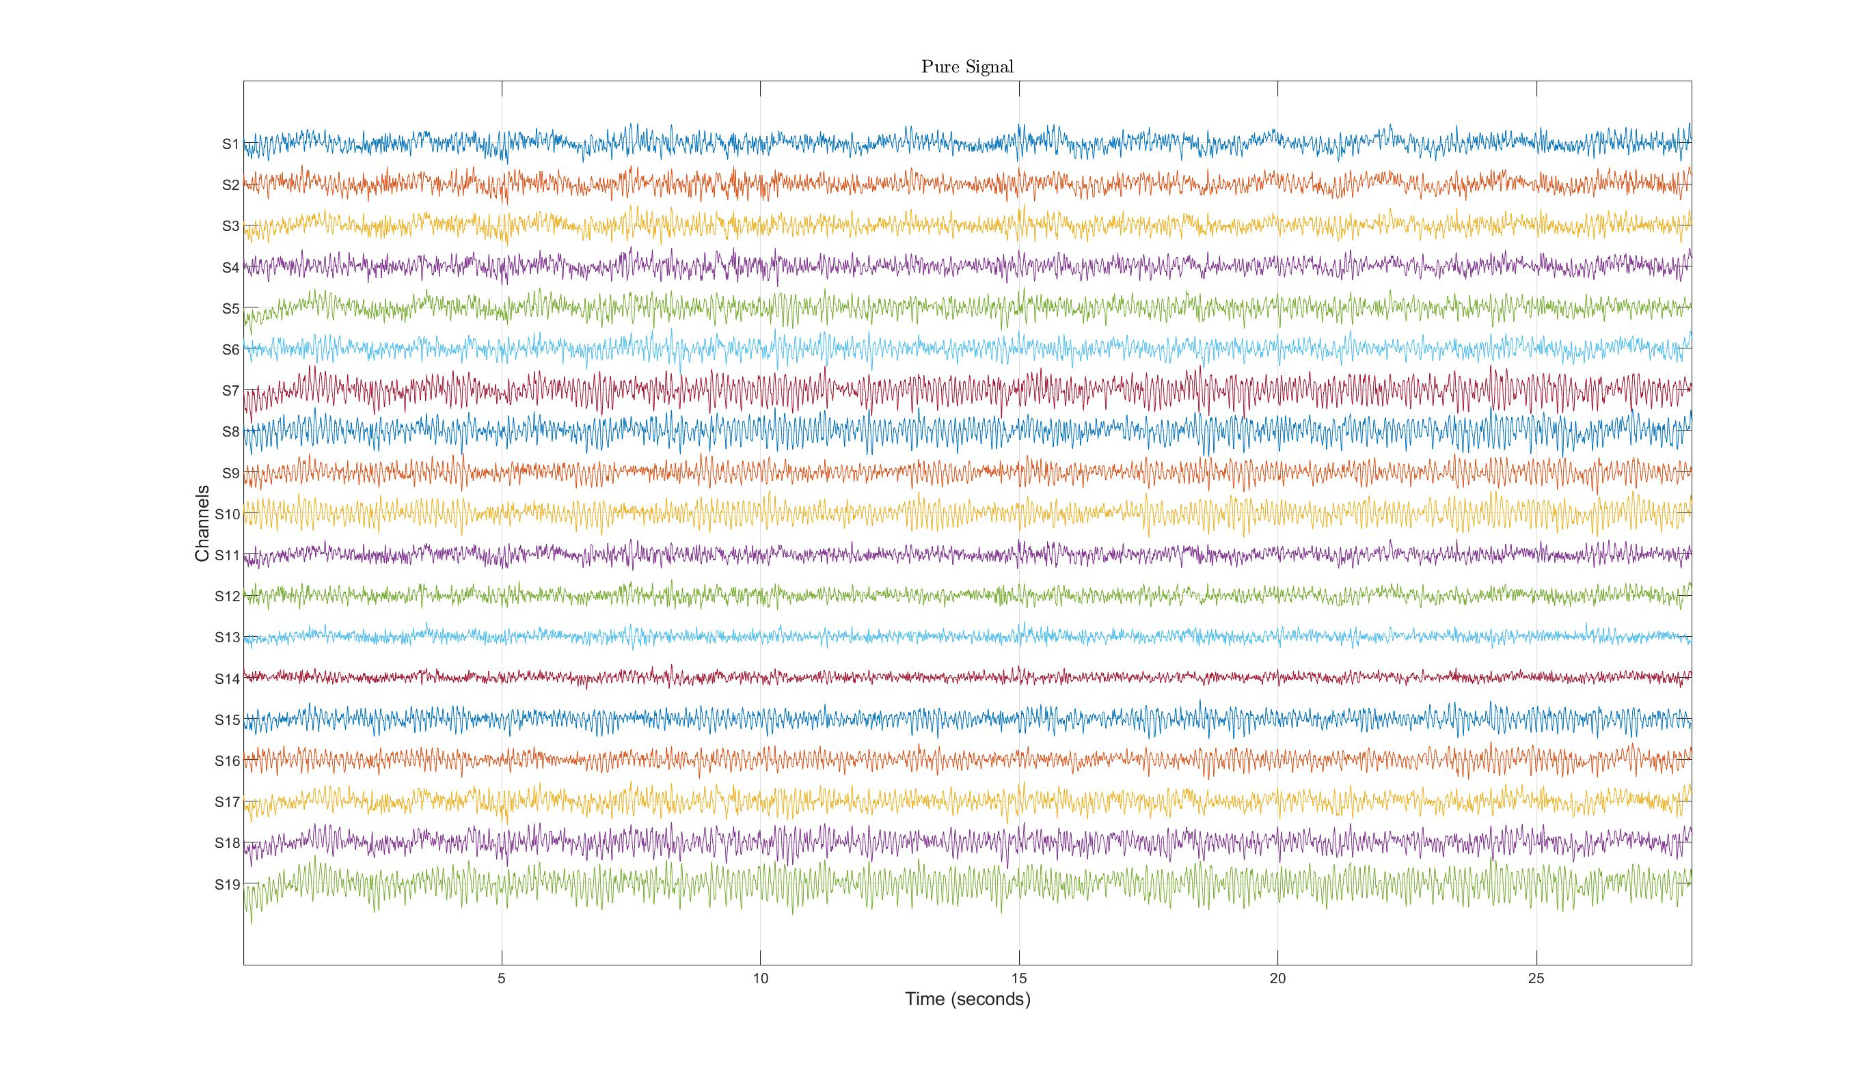
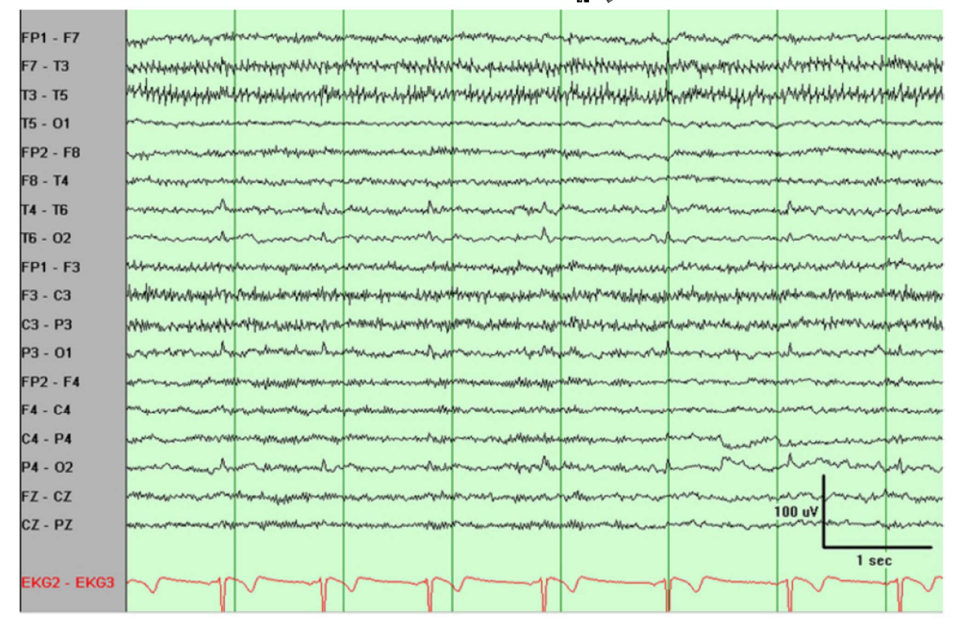
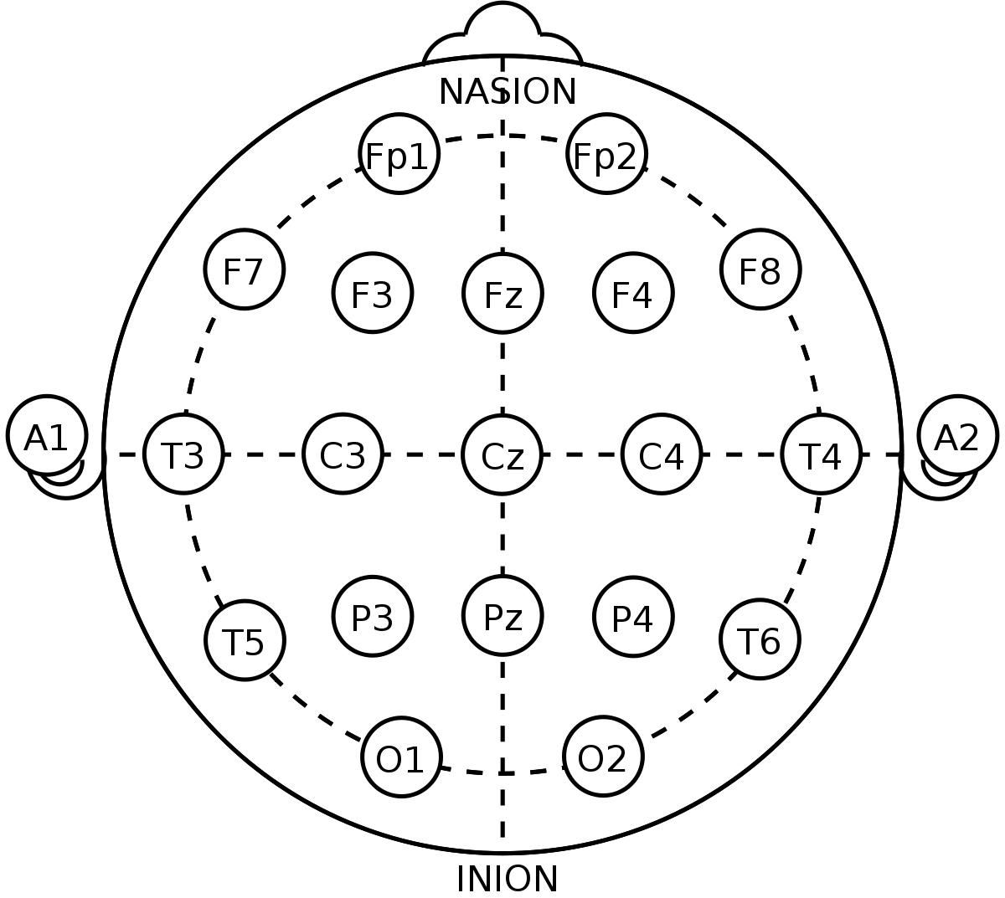
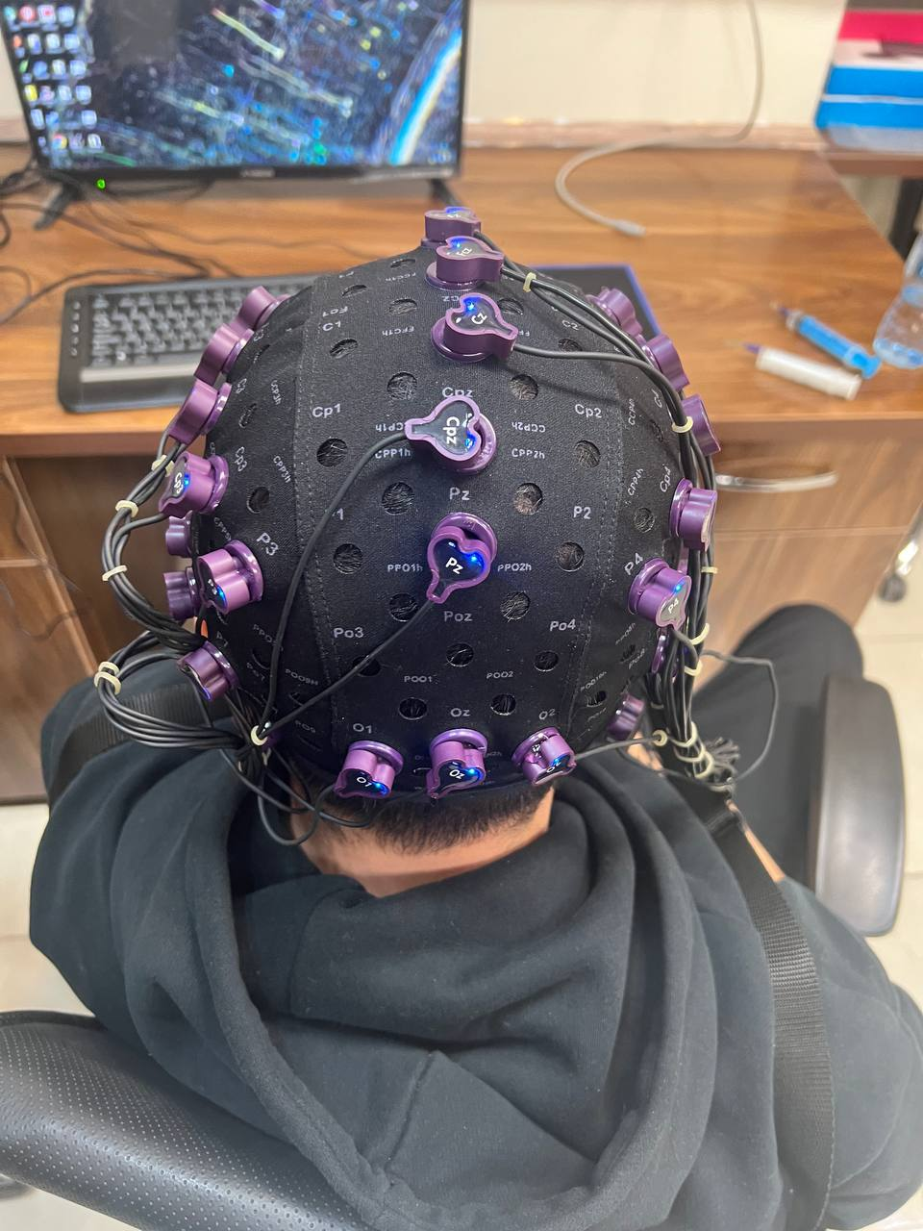
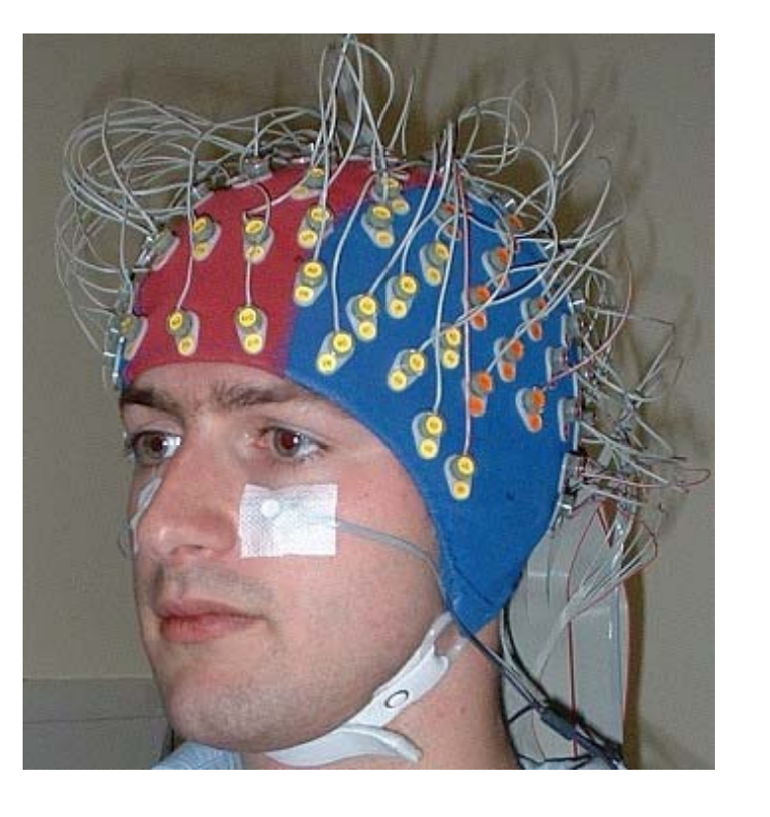
What is EEG Signal? [1]

Slide 4
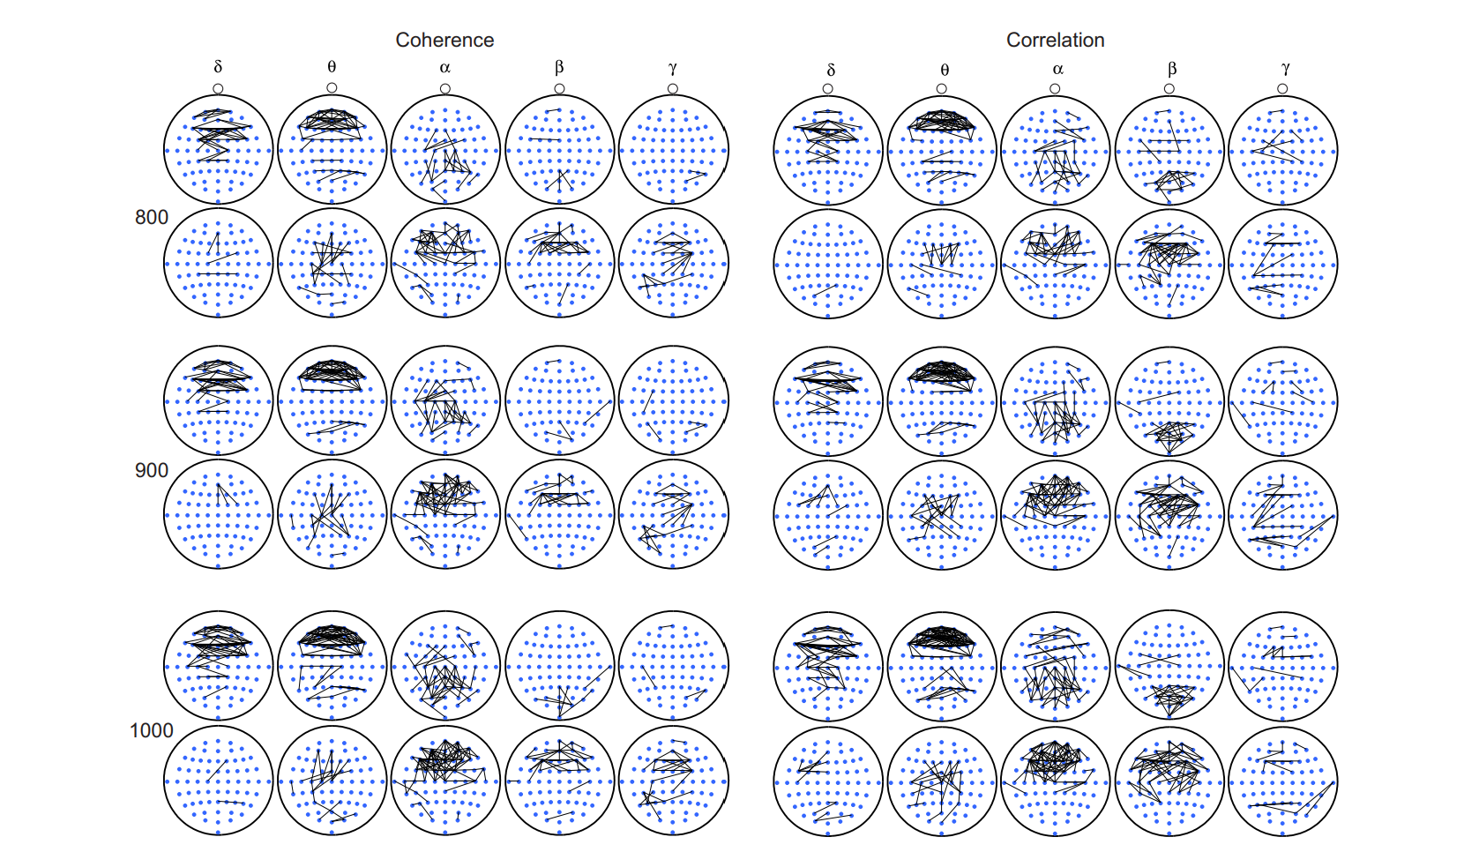
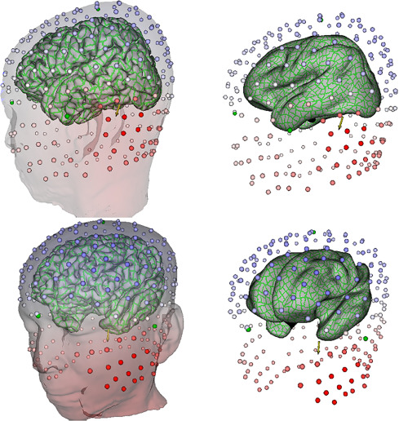
What Am I Trying To? [1][2]
CEG for open eyes (odd rows) vs closed (even rows)

Slide 5
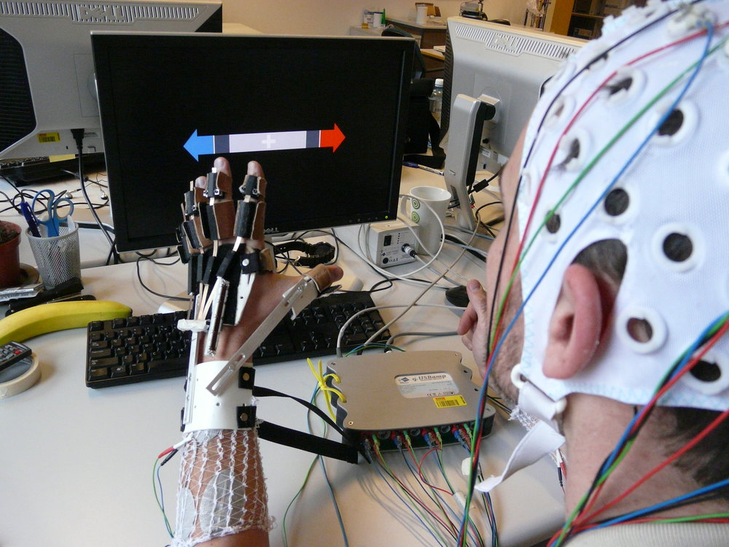
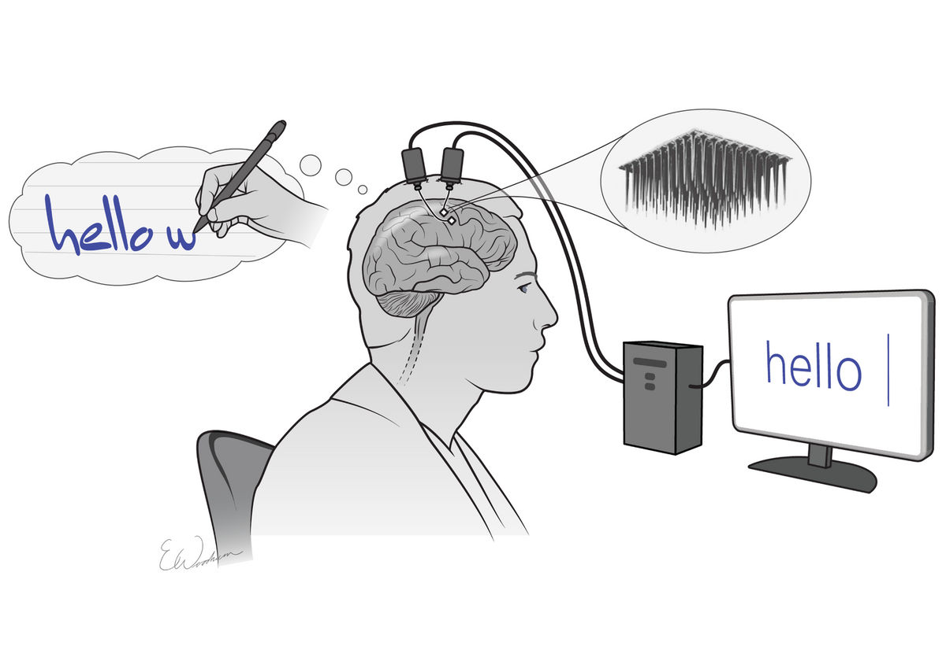
Why? [1]

Slide 6
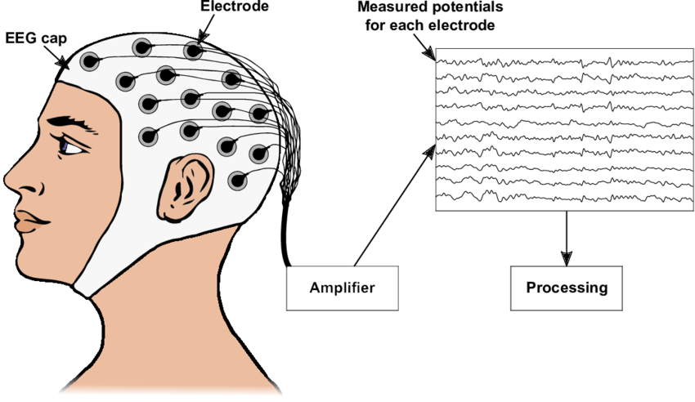
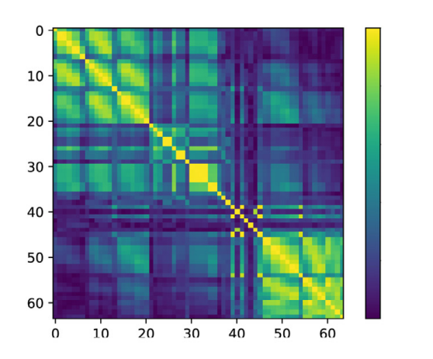
How? Graph Learning! [2][3]

Slide 7
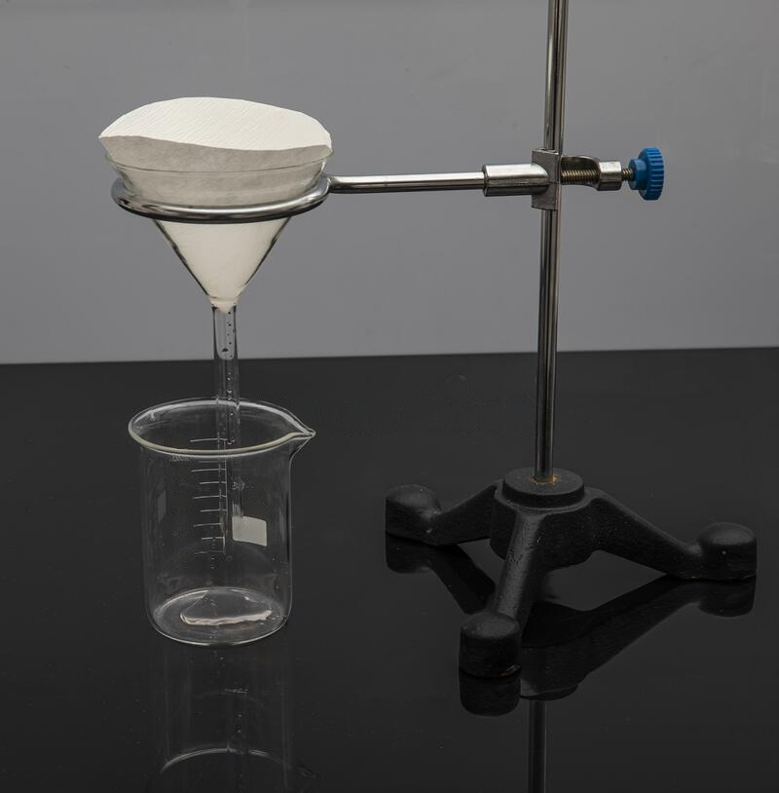
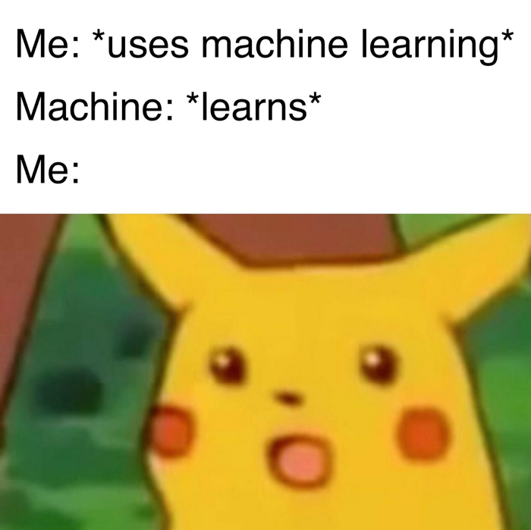
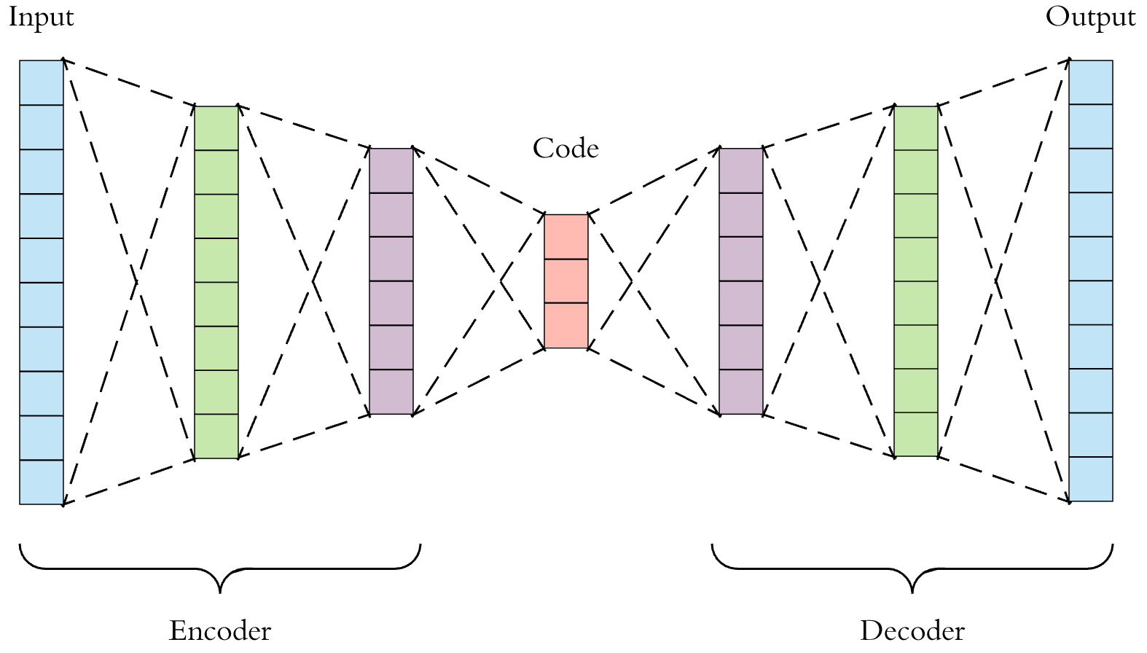
What I Want To Do? [4][7]

Slide 8
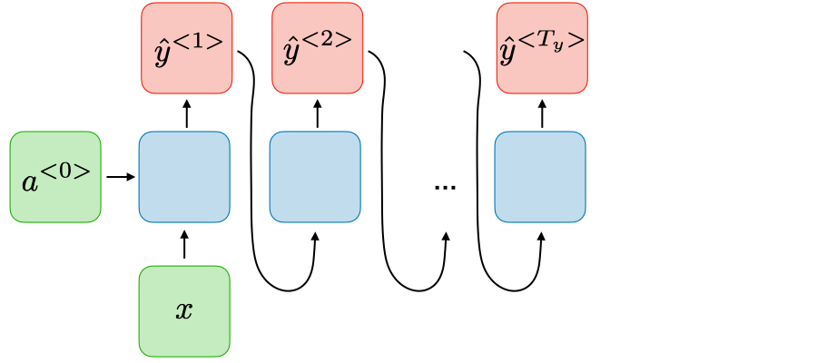
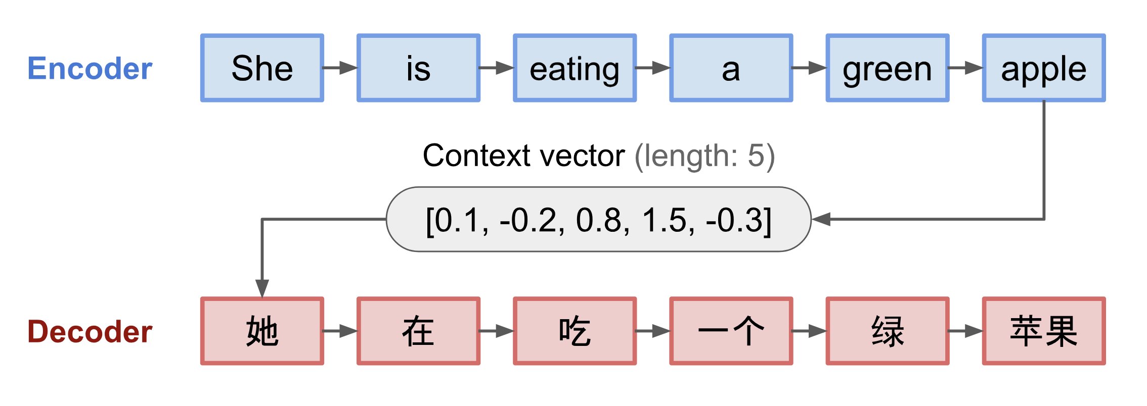
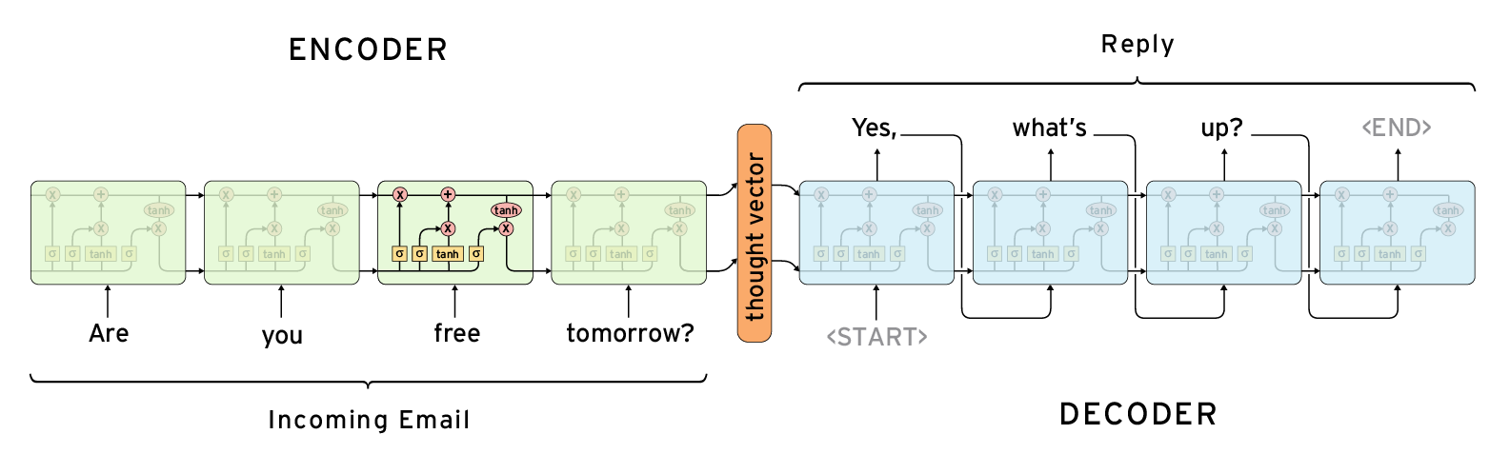
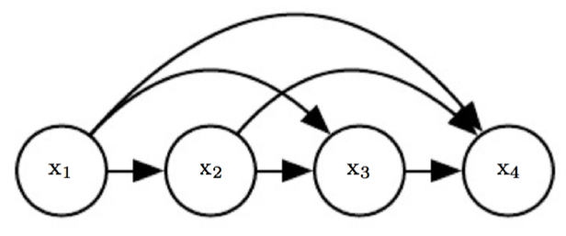
But EEG is a Time Series [8][7]

Slide 9
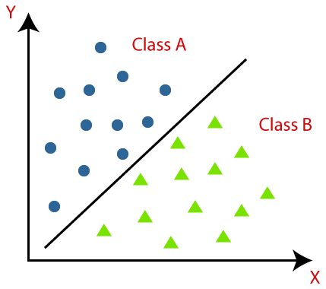
Testing Criteria [6] [10]

Slide 10
References
Hajipour Sardouie, Sepideh. " EEG Signal Processing Course Notes." Sharif University of Technology(2022). [1]
Wendling, Fabrice, et al. "From EEG signals to brain connectivity: a model-based evaluation of interdependence measures." Journal of neuroscience methods 183.1 (2009): 9-18. [2]
López, Rafae Lemuz, et al. "Graph theory for brain connectivity characterization from EEG." 2020 10th International Symposium on Signal, Image, Video and Communications (ISIVC). IEEE, 2021. [3]
Yu, Wennian, Il Yong Kim, and Chris Mechefske. "Analysis of different RNN autoencoder variants for time series classification and machine prognostics." Mechanical Systems and Signal Processing 149 (2021): 107322. [4]
Rubinov, Mikail, and Olaf Sporns. "Complex network measures of brain connectivity: uses and interpretations." Neuroimage 52.3 (2010): 1059-1069. [5]
Sen, Bhaskar, et al. "Classification of obsessive-compulsive disorder from resting-state fMRI." 2016 38th Annual International Conference of the IEEE Engineering in Medicine and Biology Society (EMBC). IEEE, 2016. [6]
Sharifi Zarchi, Ali and Azarkhalili, Behrooz. " Introduction to Machine Learning Course Notes." Sharif University of Technology(2022). [7]
Behrouzi, Tina, and Dimitrios Hatzinakos. "Graph variational auto-encoder for deriving EEG-based graph embedding." Pattern Recognition 121 (2022): 108202.[8]

Slide 11
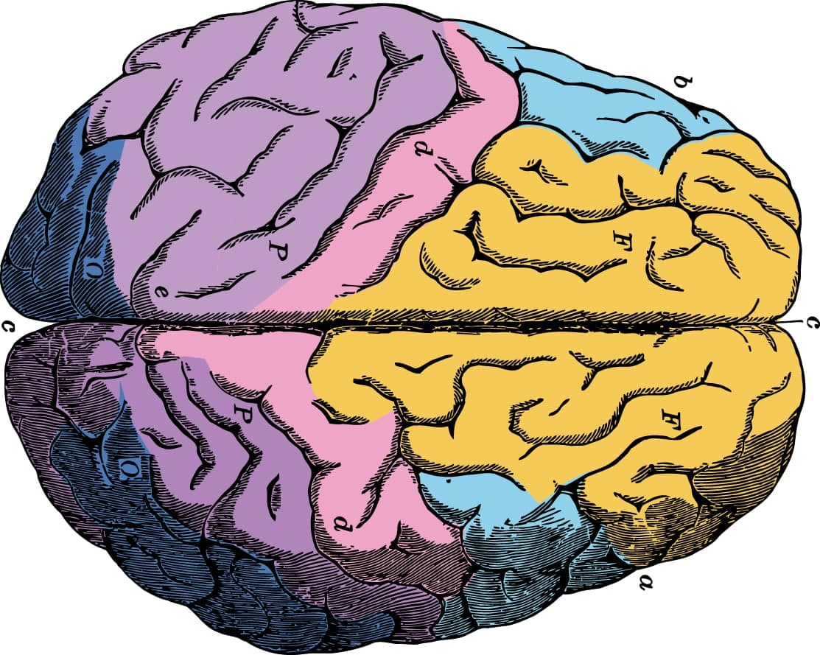
Thanks for Your Attention!

